Slide 1





qutip-qip: Pulse-level circuits simulation
qutip-qip
Boxi Li
Forschungszentrum Jülich
(Research Center Jülich)
20 September 2023

Slide 2
Content
Gate-level and Pulse-level circuit simulation
Quantum operation in the language of Hamiltonian
The role of pulse shaping
Pulse-level simulation using qutip-qip
Motivation: Error and noise described at the level of Hamiltonian
Workflow and module structure of qutip-qip
Summary & News

Slide 3
Gate-level and Pulse-level simulation

Slide 4

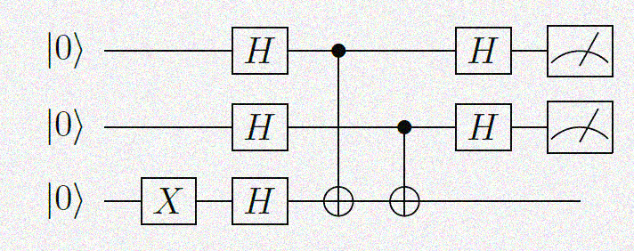



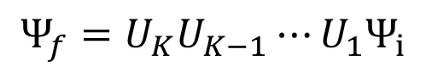
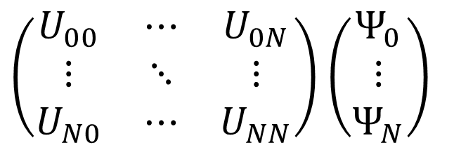
From discrete unitary gate to continuous time-evolution
$${Ψ_{f}=U}_{K}U_{K−1}⋯U_{1}Ψ_{i}$$
$\left(\begin{matrix}U_{00} & ⋯ & U_{0N} \\ ⋮ & ⋱ & ⋮ \\ U_{N0} & ⋯ & U_{NN}\end{matrix}\right)$ $\left(\begin{aligned}Ψ_{0} \\ ⋮ \\ Ψ_{N}\end{aligned}\right)$

Slide 5
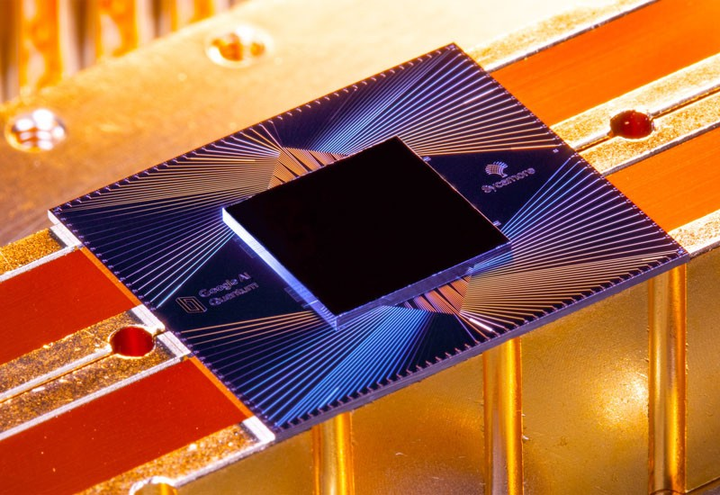
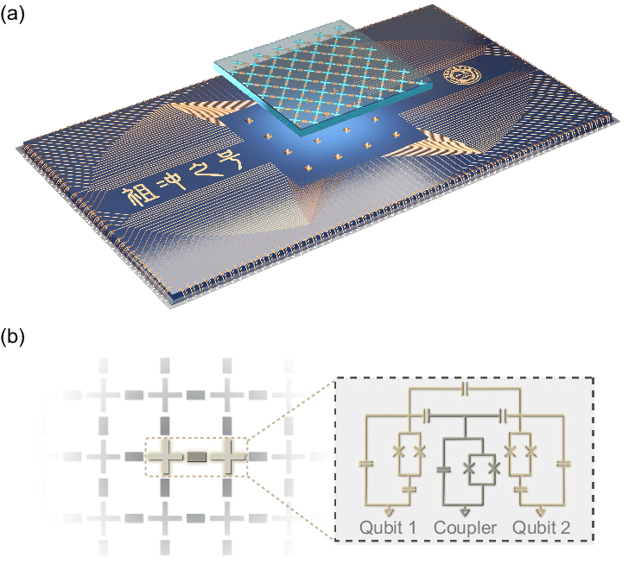

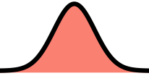
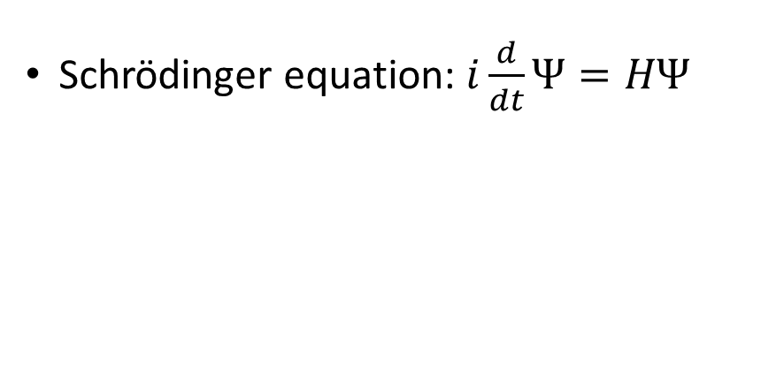

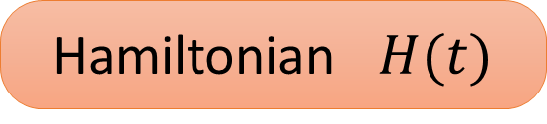
From discrete unitary gate to continuous time-evolution
Simulate circuits on physical model with real hardware.
Nature, 2019, 574(7779): 505-510.
PRL., 2021, 127(18): 180501.
Hamiltonian $H(t)$
Schrödinger equation: $i\frac{d}{dt}Ψ=HΨ$
${Ψ_{f}=U}_{K}U_{K−1}⋯U_{1}Ψ_{i}$
qutip-qip

Slide 6
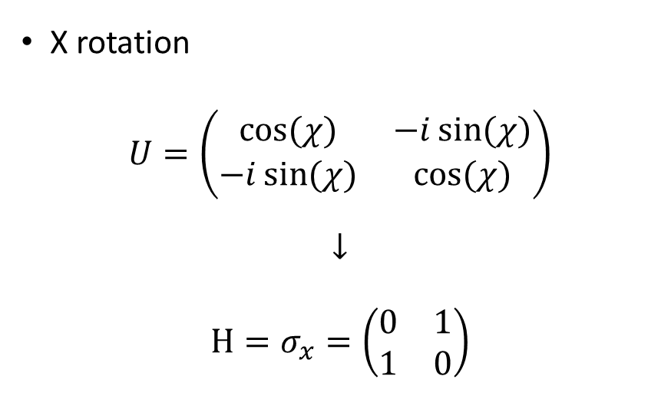
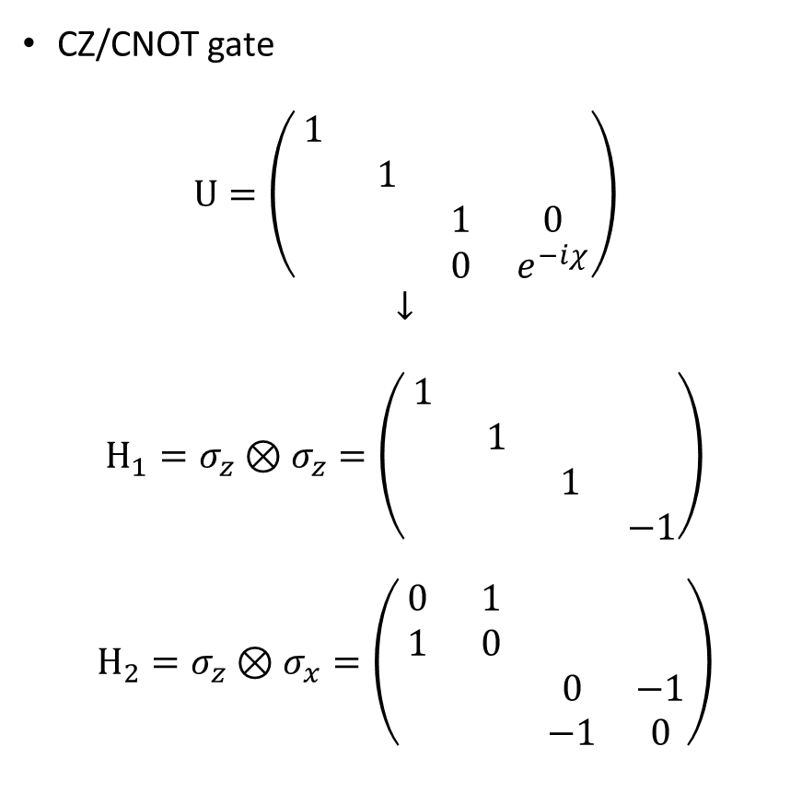
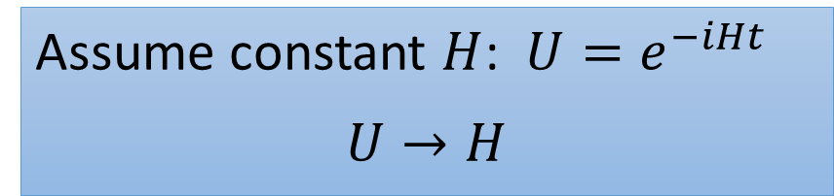
Map gates to control pulses: $U=e^{−iHt}$
Assume constant $H$: $U=e^{−iHt}$
$$U→H$$
CZ/CNOT gate
$$U=\left(\begin{matrix}1 & & & \\ & 1 & & \\ & & 1 & 0 \\ & & 0 & e^{−iχ}\end{matrix}\right)$$
$$↓$$
$$H_{1}=σ_{z}⊗σ_{z}=\left(\begin{matrix}1 & & & \\ & 1 & & \\ & & 1 & \\ & & & −1\end{matrix}\right)$$
$$H_{2}=σ_{z}⊗σ_{x}=\left(\begin{matrix}0 & 1 & & \\ 1 & 0 & & \\ & & 0 & −1 \\ & & −1 & 0\end{matrix}\right)$$
X rotation
$$U=\left(\begin{matrix}cos⁡(χ) & −i\sin{(χ)} \\ −i\sin{(χ)} & cos⁡(χ)\end{matrix}\right)$$
$$↓$$
$$H=σ_{x}=\left(\begin{matrix}0 & 1 \\ 1 & 0\end{matrix}\right)$$

Slide 7
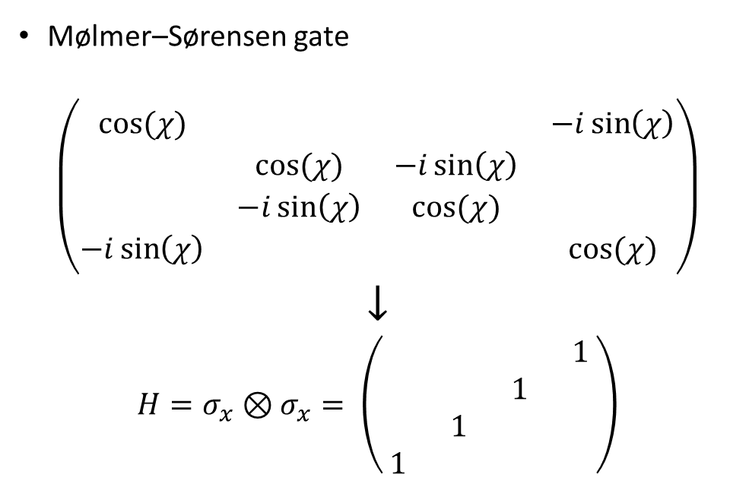
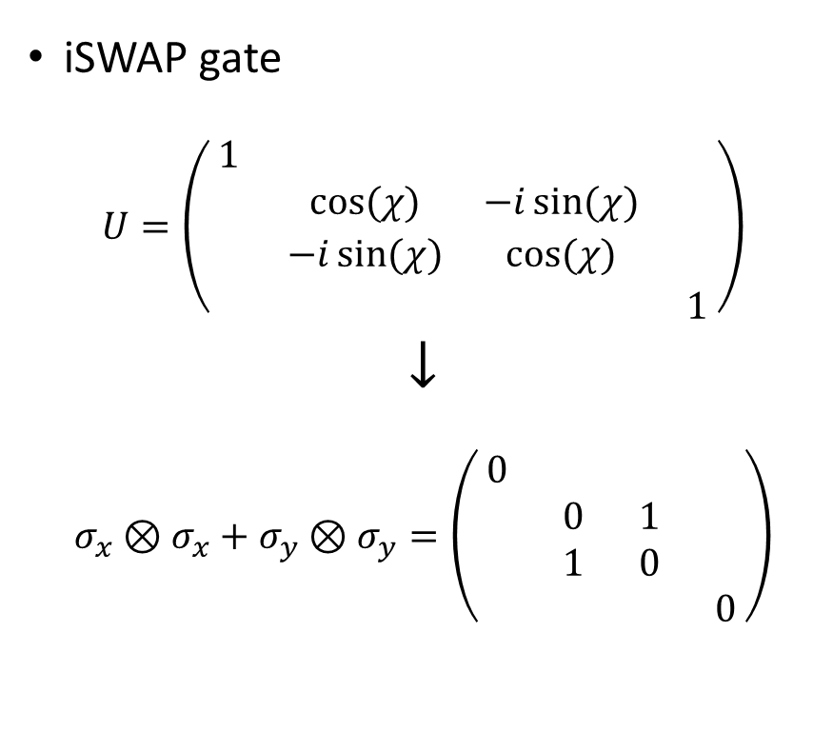
Map gates to control pulses: $U=e^{−iHt}$
Assume constant $H$: $U=e^{−iHt}$
$$U→H$$
iSWAP gate
$$U=\left(\begin{matrix}1 & & & \\ & cos⁡(χ) & −i\sin{(χ)} & \\ & −i\sin{(χ)} & cos⁡(χ) & \\ & & & 1\end{matrix}\right)$$
$$↓$$
$$σ_{x}⊗σ_{x}+σ_{y}⊗σ_{y}=\left(\begin{matrix}0 & & & \\ & 0 & 1 & \\ & 1 & 0 & \\ & & & 0\end{matrix}\right)$$
Mølmer–Sørensen gate
$$\left(\begin{matrix}cos⁡(χ) & & & −i\sin\left(χ\right) \\ & cos⁡(χ) & −i\sin\left(χ\right) & \\ & −i\sin\left(χ\right) & cos⁡(χ) & \\ −i\sin\left(χ\right) & & & cos⁡(χ)\end{matrix}\right)$$
$$↓$$
$${H=σ}_{x}⊗σ_{x}= \left(\begin{matrix} & & & 1 \\ & & 1 & \\ & 1 & & \\ 1 & & & \end{matrix}\right)$$

Slide 8
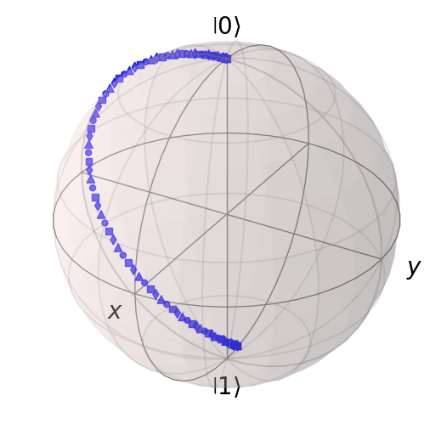
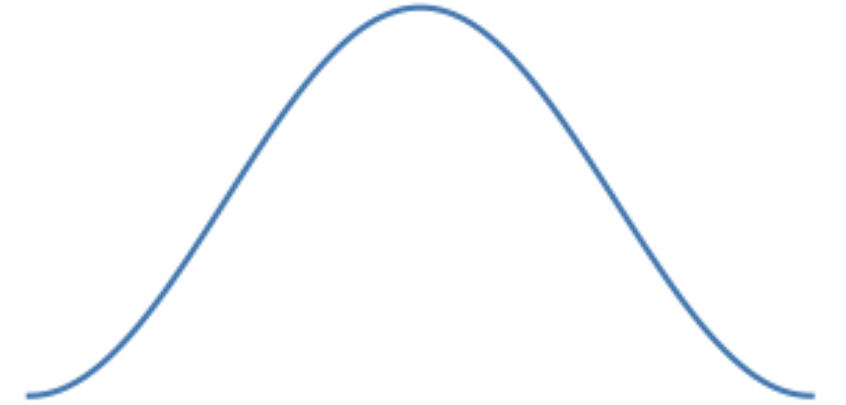
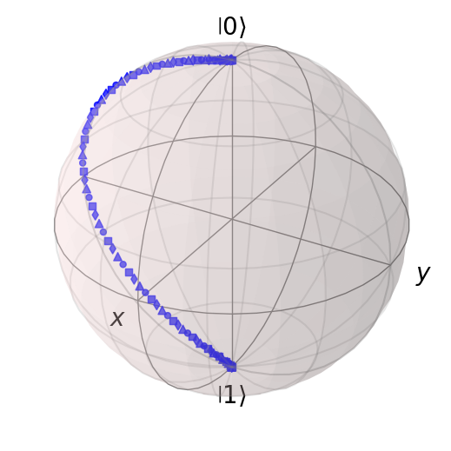
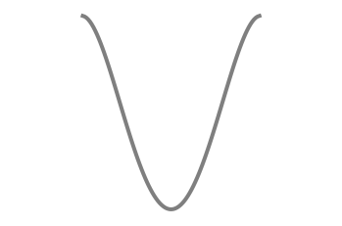
The role of pulse shaping: example 1 DRAG pulse
Square pulse
Hann pulse
DRAG pulse
Motzoi et al. PRL 103, 110501 (2009)
Review: Theis et al. EPL 123 60001 (2018)

Slide 9
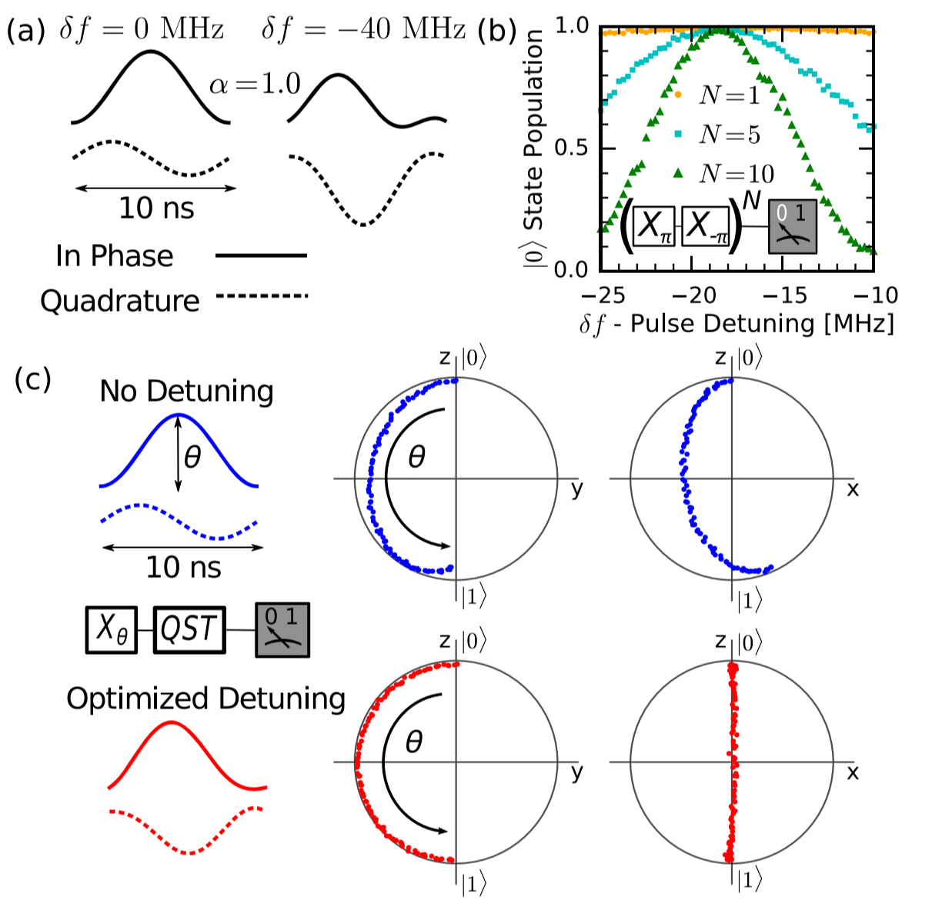
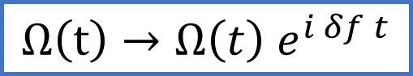
The role of pulse shaping: example 2 Pulse modulation
$$Ω\left(t\right)→Ω\left(t\right) e^{i δf t}$$
Chen et al. PRL 116, 020501 (2016)

Slide 10
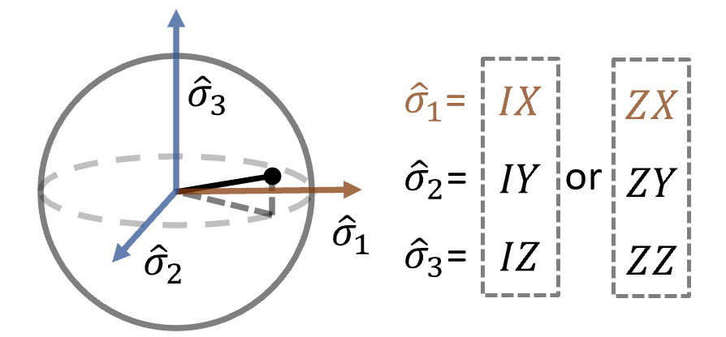
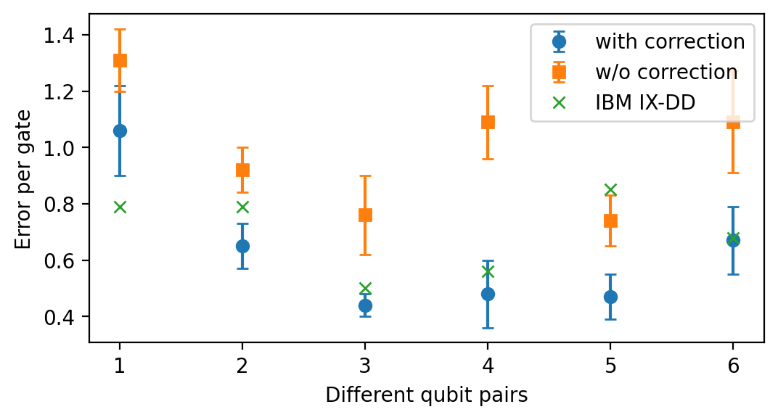
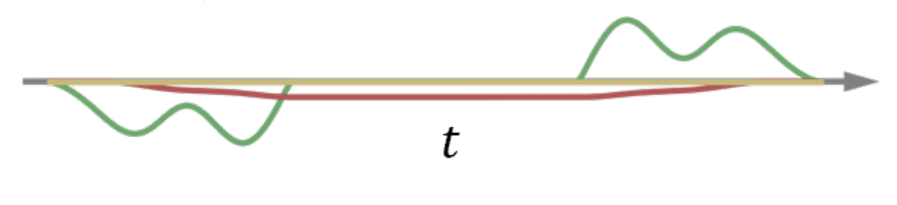
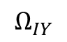
The role of pulse shaping: application to Cross Resonance gate
$$Ω_{IY}$$
detuning
B. Li et al. arXiv: 2303.01427

Slide 11
Pulse-level circuit simulation with qutip-qip

Slide 12
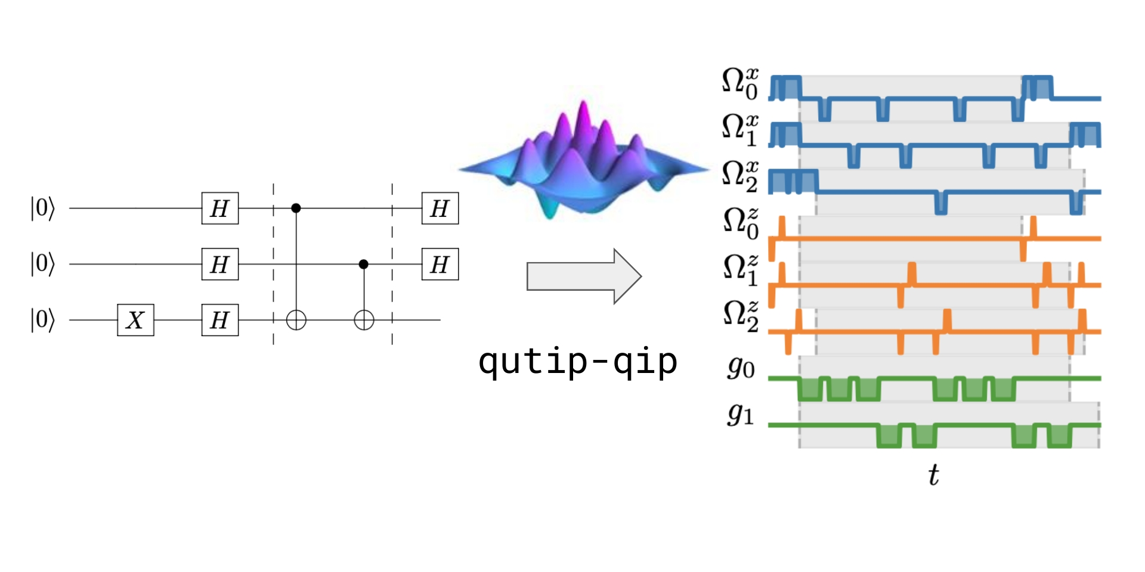
Long story short

Slide 13
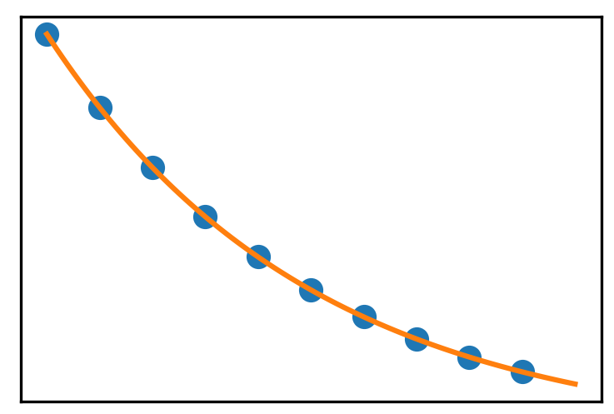
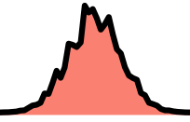
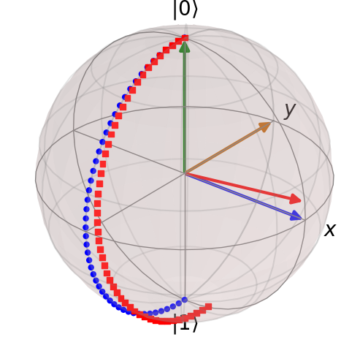
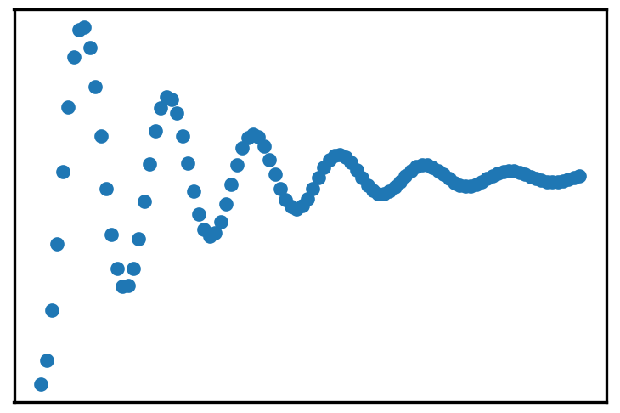
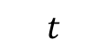
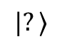

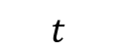
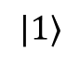
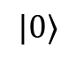



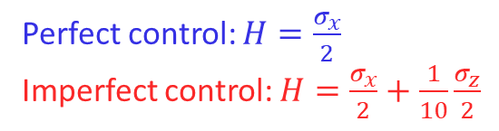
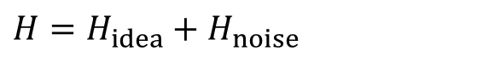
Motivation: Error and noise described at the level of Hamiltonian
Decoherence noise
Control Noise
$H=H_{idea}+H_{noise}$
signal
Pulse shape noise
$$|?⟩$$
$$t$$
signal
Cross-talk noise
$$|1⟩$$
$$|0⟩$$
Perfect control: $H=\frac{σ_{x}}{2}$
Imperfect control: $H=\frac{σ_{x}}{2}+\frac{1}{10}\frac{σ_{z}}{2}$
Leakage noise
$$t$$

Slide 14
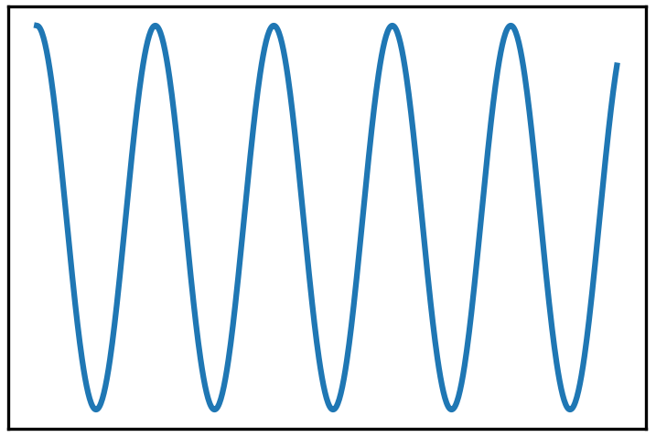
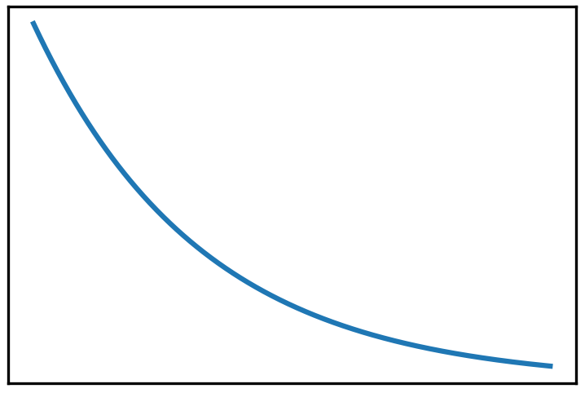
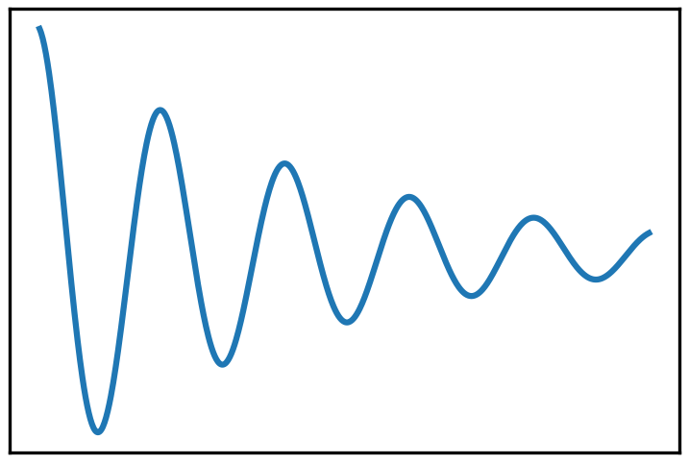
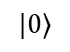
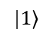
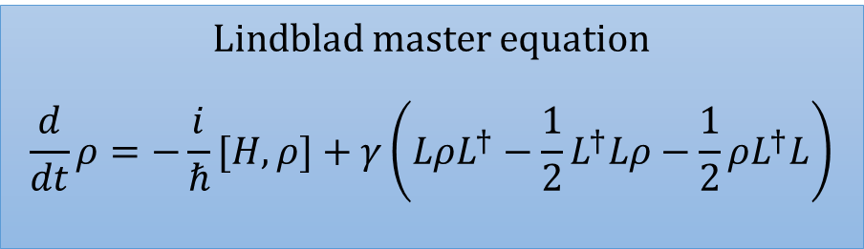
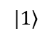
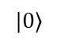
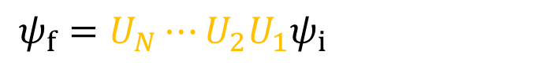
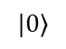
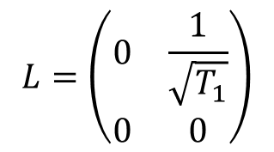
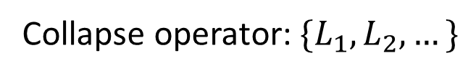
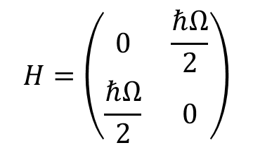
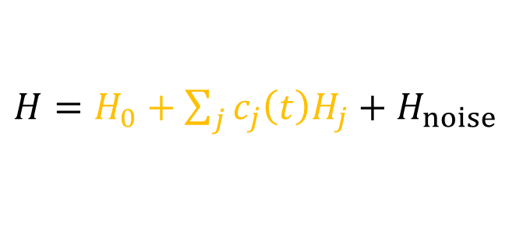
Motivation: Error and noise described at the level of Hamiltonian
$$ψ_{f}=U_{N}⋯U_{2}U_{1}ψ_{i}$$
Hamiltonian
Collapse operator
$$H=\left(\begin{matrix}0 & \frac{ℏΩ}{2} \\ \frac{ℏΩ}{2} & 0\end{matrix}\right)$$
$$L=\left(\begin{matrix}0 & \frac{1}{\sqrt{T_{1}}} \\ 0 & 0\end{matrix}\right)$$
$H=H_{0}+\sum_{j}{c_{j}\left(t\right)H_{j}}+H_{noise}$
Collapse operator: $\{L_{1}, L_{2}, …\}$
$$|1⟩$$
$$|1⟩$$
Lindblad master equation
$$\frac{d}{dt}ρ=−\frac{i}{ℏ}[H,ρ]+γ\left(LρL^{†}−\frac{1}{2}L^{†}Lρ−\frac{1}{2}ρL^{†}L\right)$$
$$|0⟩$$
$$|0⟩$$
$$|1⟩$$
Simulated using OED solver & Monte Carlo Solver in QuTiP
$$|0⟩$$
Notes:
Physicists like to use equations. Compare to Newton equation.

Slide 15
QuTiP: Quantum Toolbox in Python
sequencing
qutip
Qobj representation
visualization tools
dynamic solvers
qutip-control
optimal control framework
qutip-qip
circuit simulation
hardware simulation
BoFiN
SQWalk
qutip-tensorflow
qutip-jax
seQuencing
filter_functions
scqubits
Krotov
Pulser
QGrad
PIQS
PyKrylovSolver

Slide 16
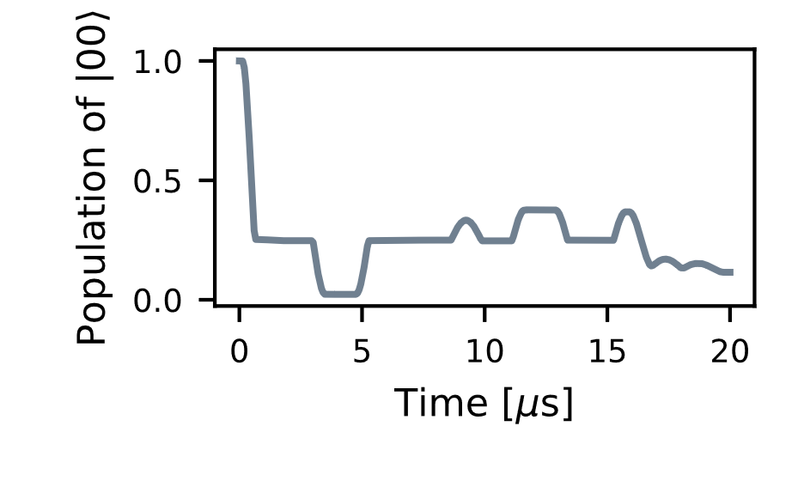



qutip-qip: overview
QASM Circuit
Result
Qiskit
Cirq
Project Q
$$⋯$$
Density matrix
Evolution trajectory
Compile circuit to pulses
Pass it to QuTiP solvers
Simulated Processor
Noise
Spin chain
Cavity QED
Circuit QED
Optimal control
Generate noisy pulses
Decoherence
Amplitude noise
Cross-talk
Leakage error
B. Li et al. Quantum, 2022, 6: 630

Slide 17







qutip-qip: Pulse representation of a circuit
$H=H_{0}+\sum_{j}{c_{j}\left(t\right)H_{j}}+H_{noise}$
$c_{j}(t)$ is defined for the full circuit
$$\frac{d}{dt}ρ=−\frac{i}{ℏ}[H,ρ]+γ\left(LρL^{†}−\frac{1}{2}L^{†}Lρ−\frac{1}{2}ρL^{†}L\right)$$
Collapse operator: $\{L_{1}, L_{2}, …\}$
Control Hamiltonian
Target qubits
Pulse coefficients
Time sequence
Ideal pulse
Ideal Pulse
$$c_{j}\left(t\right)H_{j}$$
$$H_{j}=\left(\begin{matrix}0 & 1 \\ 1 & 0\end{matrix}\right)$$
Coherent noise
Pulse
(Coherent dynamics)
Qubit 0
$$c_{j}\left(t\right)H_{j}$$
Lindblad noise
Qubit 1
(Dissipative dynamics)
Qubit 2
Notes:
In stead of gate-based simulator, the basic element is pulse

Slide 18





qutip-qip: Pulse representation of a circuit
$H=H_{0}+\sum_{j}{c_{j}\left(t\right)H_{j}}+H_{noise}$
$c_{j}(t)$ is defined for the full circuit
$$\frac{d}{dt}ρ=−\frac{i}{ℏ}[H,ρ]+γ\left(LρL^{†}−\frac{1}{2}L^{†}Lρ−\frac{1}{2}ρL^{†}L\right)$$
Collapse operator: $\{L_{1}, L_{2}, …\}$
Ideal pulse
$$H_{j}$$
Coherent noise
$$H_{noise}$$
$$f( )$$
Pulse
(Coherent dynamics)
$$c_{j}\left(t\right)H_{j}$$
Lindblad noise
$$L_{1}$$
$$f( )$$
(Dissipative dynamics)
Pulse shape represented by a NumPy array or (in the future) an analytical expression
Notes:
In stead of gate-based simulator, the basic element is pulse

Slide 19





qutip-qip: Examples of compiled circuits
Realistic and flexible simulation of circuits on noisy quantum processors:
Custom compiler map
$\text{X}\text{,}\text{Y}→$
$\text{CNOT}→$
$\text{H}→ X\sqrt{Y}→⋯$
Closely integrated with different QuTiP solvers: mesolve, mcsolve
Define noise according to the Lindblad model: cross-talk, leakage.
Import and export circuits in the OpenQASM standard.
Qubits simulated as 3-level systems
Quantum, 2022, 6: 630. arXiv:2105.09902
Notes:
Add links

Slide 20



qutip-qip: Including decoherence in the simulation

Slide 21


qutip-qip: Simulation time
Example: a 10-qubit QFT algorithm
Dominant by the dynamic solver
Depend not only on the input circuit, but also on the physical model.

Slide 22
Summary & Outlook

Slide 23

Summary
Hamiltonian model behind the unitary representation of quantum gate.
Pulse shaping play an important role in improving the quality of gate operations.
qutip-qip: simulating quantum circuits at the Hamiltonian level
Setup Hamiltonian models with a few lines of code.
Compare different error source.
Design calibration procedure and data analysis.
Tutorial
https://qutip.org/tutorials.html
DRAG: Theis et al. EPL 123 60001 (2018)
DRAG for CR: Li et al. arXiv: 2303.01427
Li et al. Quantum, 2022, 6: 630

Slide 24



News: Custom data type and custom solvers in qutip-v5
pip install qutip==5.0.0a2
Custom data types:
Flexible Dense and CSR representation of Qobj #1296 #1332
Data-layer type creation, conversion and dispatch #1338
Custom solvers:
Representation of a time-dependent Lindblad model #1481
Solver class #1462
Swappable ODE integrators. #1643
mcsolve
$$⋯$$
mesolve
Custom solver
Qobj & QobjEvo
NumPy
CSR sparse
CuPy
TensorFlow
Doc: https://jakelishman.github.io/qutip-devguide/qutip/data-layer/index.html

Slide 25


News: Other new features
qutip-qip as a Qiskit backend
JAX data backend for QuTiP: qutip-jax
https://qutip-qip.readthedocs.io/en/stable/qip-qiskit.html

Slide 26

News: QuTiP GSoC 2023 Presentations
Wednesday, Oct 25, 2023
CET 2pm/UTC 12am/EDT 8am
- Trent Fridey: QuTiP Virtual Lab https://qutip.org/qutip-virtual-lab/
- Yuji Tamakosho: Visualisation with QuTiP
Link: http://meet.google.com/cff-mbht-zkr
More information:
search for the Google Group of QuTiP

Slide 27
Backup

Slide 28

Different modules in the package
Model: Available control Hamiltonian
Spin chain model
Cavity QED
Circuit QED
Optimal control
Compiler: A compiler for each model
Scheduler: Pulse scheduling
Noise: drift noise, decoherence, pulse amplitude + custom noise

Slide 29


Summary: Gate-level vs. Pulse-level simulation
Gate-level circuit simulation:
Ideal circuit: $ψ_{f}=U_{N}⋯U_{2}U_{1}ψ_{i}$
Noisy circuit: $ρ_{i+1}=\sum_{j}{K_{j}{U_{i}ρ}_{i}U_{i}^{†}K^{†}}$
Pulse-level circuit simulation:
Ideal circuit: $H=H_{0}+\sum_{j}{c_{j}\left(t\right)H_{j}}$
Noisy circuit:
Coherent noise: $H_{noise}$
Dissipative noise: Collapse operators $\{L_{1}, L_{2}, …\}$
$$\frac{d}{dt}ρ=−\frac{i}{ℏ}[H,ρ]+γ\left(LρL^{†}−\frac{1}{2}L^{†}Lρ−\frac{1}{2}ρL^{†}L\right)$$

Slide 30

Noise defined at the gate-level
How is noise usually simulated at the gate-level?
Random Pauli error
Quantum channel: decoherence, dephasing, erasure …
Assumptions
Noise are usually independent among qubits
Usually applied after perfect gate $ρ_{i+1}=\sum_{j}{K_{j}{U_{i}ρ}_{i}U_{i}^{†}K^{†}}$
More realistic picture
Noise are correlated, both in time and in space.
The operation and noise are not separable.

Slide 31



Future development: Custom data type and custom solvers in qutip-v5
qutip-tensorflow @ https://github.com/qutip/qutip-tensorflow
qutip-cupy @ https://github.com/qutip/qutip-cupy
by Asier Galicia and Felipe Haiek through Google Summer of Code
TensorFlow + QuTiP
PRL, 2021, 127(14): 140502.
PRR, 2021, 3(3): 033278.
GPU acceleration
Automatic differentiation
https://github.com/qutip/qutip-tensorflow/blob/main/examples/rotation_optimization.ipynb
ODE integration under development
From https://cupy.dev/

Slide 32

Framework architecture – overview

Slide 33


Quantum circuit in QuTiP
>>> from qutip.qip.circuit import QubitCircuit
>>> circuit = QubitCircuit(3)
>>> circuit.add_gate("CNOT", targets=1, controls=0)
>>> circuit.add_gate("RX", targets=1, arg_value=np.pi/2)
>>> final_state = circuit.run(initial_state)

Slide 34

From discrete unitary gate to continuous time-evolution
Magann, Alicia B., et al. "From pulses to circuits and back again: A quantum optimal control perspective on variational quantum algorithms." PRX Quantum 2.1 (2021): 010101.

Slide 35



















QuTiP: The Quantum Toolbox in Python
Johansson, J. Robert, P. D. Nation, and Franco Nori.
Comput. Phys. Commun.183.8 (2012): 1760-1772.
Comput. Phys. Commun.184.4 (2013): 1234-1240.
And other 100+ contributors on GitHub

Slide 36






QuTiP: The Quantum Toolbox in Python
QuTiP
Quantum operators
Predefined quantum states
Bloch sphere
Wigner function

